Slide 1
Vocabulary
Unit 2

Slide 2
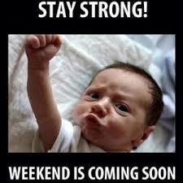
adroit
You can do it!

Slide 3
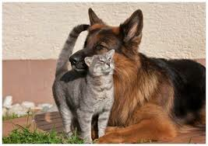
The couple remained amicable after their breakup, allowing their friend group to remain intact.
amicable

Slide 4
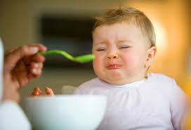
averse
It is unfortunate that Nate is averse to the outdoors; his parents are planning a camping trip for Spring Break.

Slide 5
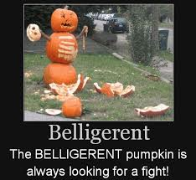
The belligerent made a poor solider because he was unable to remain focused on his duties.
belligerent

Slide 6
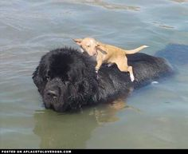
benevolent
The new girl felt very lucky to be in a class with many benevolent students.

Slide 7
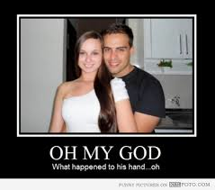
cursory
Her cursory perusal of the shelf caused her to miss the bag of chocolate chips she needed for the dish.

Slide 8
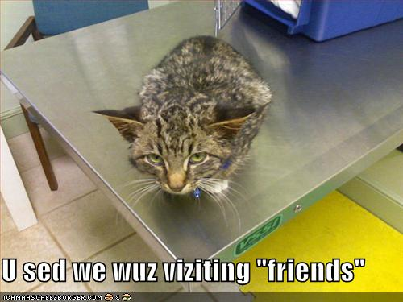
In order to get the job she wanted, the woman was open to duplicity and cheating.
duplicity

Slide 9
extol
No matter how terrible a musical group is, its fans will extol its music to anyone who will listen.

Slide 10
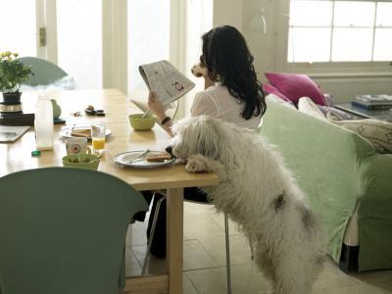
feasible able

Slide 11
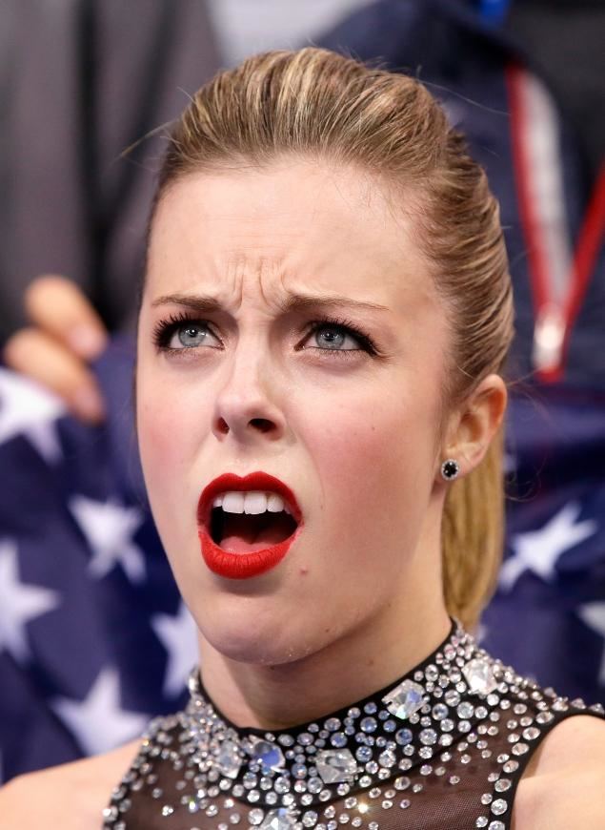
grimace
Ashley Wagner will regret grimacing at the announcement of her scores during the Olympics because that is all people are talking about.

Slide 12
holocaust
I knew I’d lost this level when I saw my player’s car surrounded by the large holocaust.

Slide 13
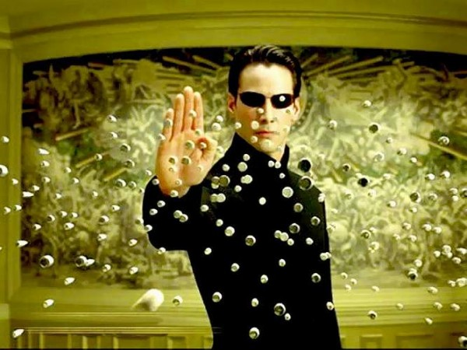
impervious
impenetrable

Slide 14
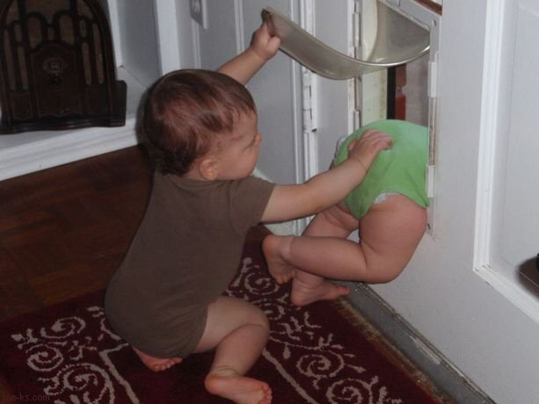
impetus
push

Slide 15
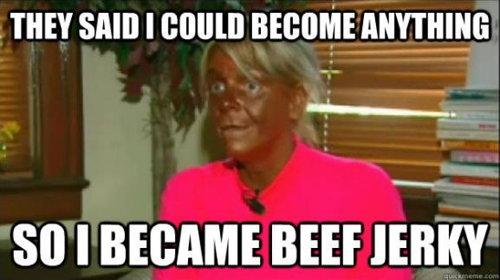
Tan Mom is in jeopardy of losing all her skin.
jeopardy

Slide 16
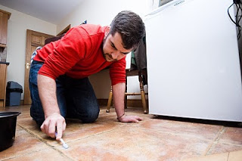
meticulous
People with germ phobias are extremely meticulous about cleaning everything.

Slide 17
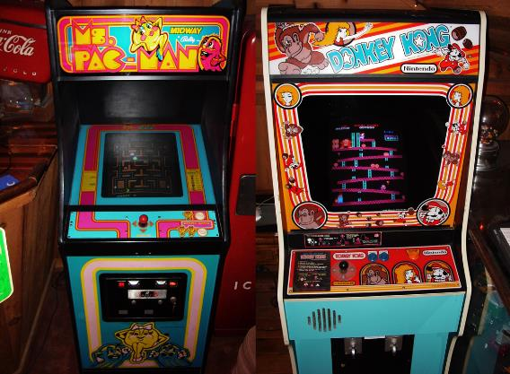
nostalgia
I always have a sense of nostalgia when I remember back to the videogames of my childhood.

Slide 18
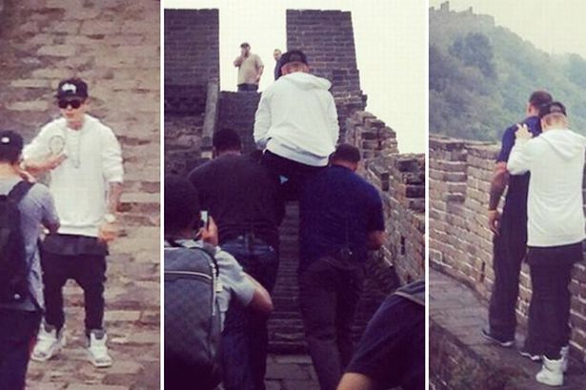
Asking to be carried somewhere when you have every ability to walk is the quintessence of laziness.
quintessence

Slide 19
retrogress
return

Slide 20
scrutinize
analyze

Slide 21
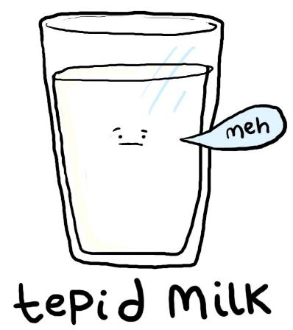
We expected they would be enthusiastic about the unexpected vacation, but their reactions were merely tepid.
tepid
mild

